Slide 1
MOGRA (JASMINE)

Slide 2

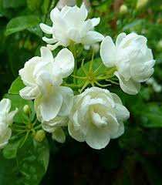
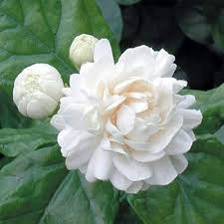

Slide 3
Common Name- Jasmine
Scientific Name- Jasminum Officinale
Family- Oleaceae.
Habit- Jasmine can be either deciduous (leaves falling in autumn)
or evergreen (green all year round) and can be erect, spreading,
or climbing shrubs and vines.
Distribution- Originally from West Asia, the Indian subcontinent, Northeast Africa and East Africa. Their center of diversity is in South Asia and Southeast Asia.

Slide 4
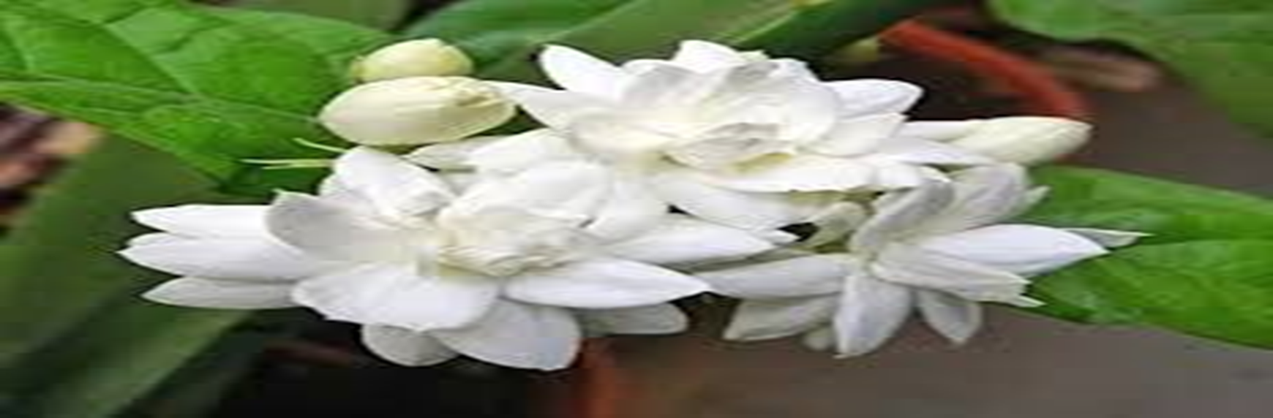
Common jasmine is a climbing shrub that can grow up to 8 meters tall. The leaves are made up of 7 to 9 smaller ‘leaflets’, which are long, pointed and oval shaped. The flowers are white or very pale pink, with five petals and strongly scented. The fruits are small black berries. Their leaves are borne in opposing or alternating arrangement.

Slide 5
.
USES OF JASMINE
Uses of jasmine are as follows-
Mental alertness.
Cancer Treatment.
It can heal liver disease (hepatitis)
To cause relaxation.
To flavor beverages.
For making perfume.

Slide 6
.
USES OF JASMINE
Uses of jasmine are as follows-
It used for making tea
It used in making of rice.
It used as soap, shampoo and sometime as oil.
On skin it is applied for antioxidant and anti-wrinkle.
It also signifies good fortune according to Indian culture.

Slide 7



